Slide 1


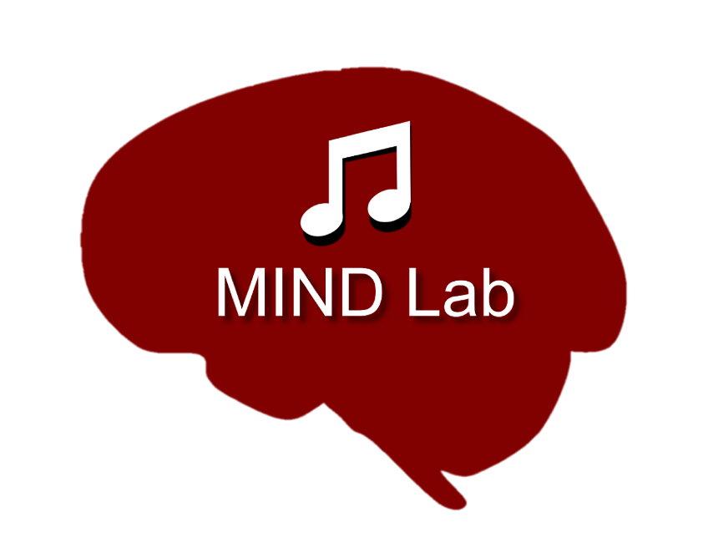
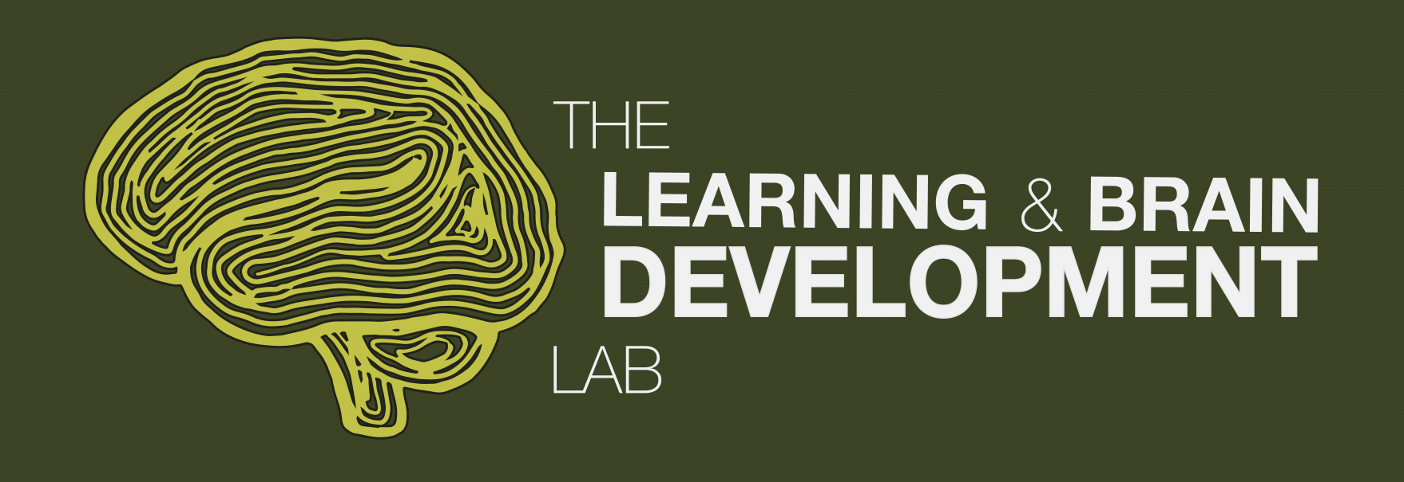

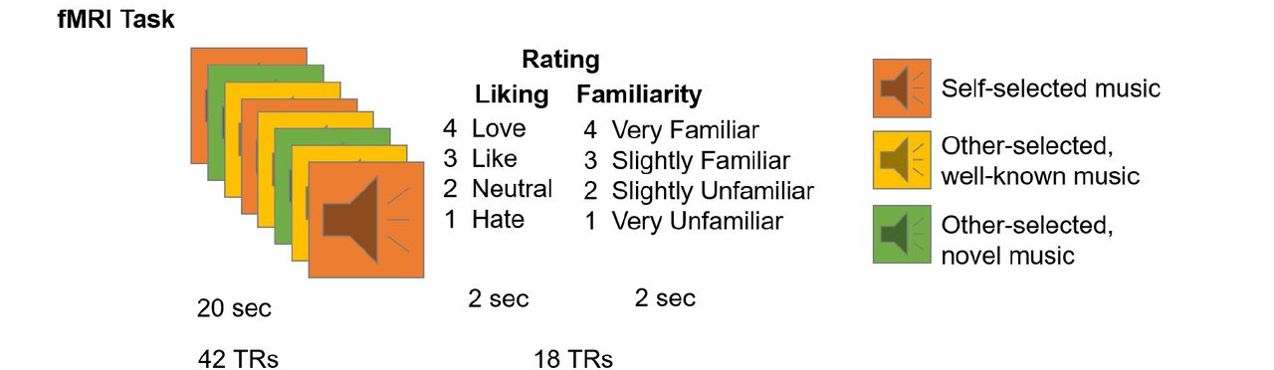

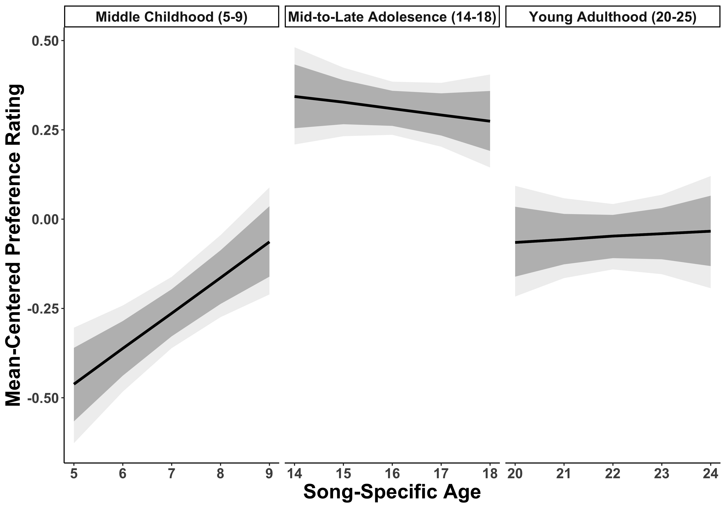
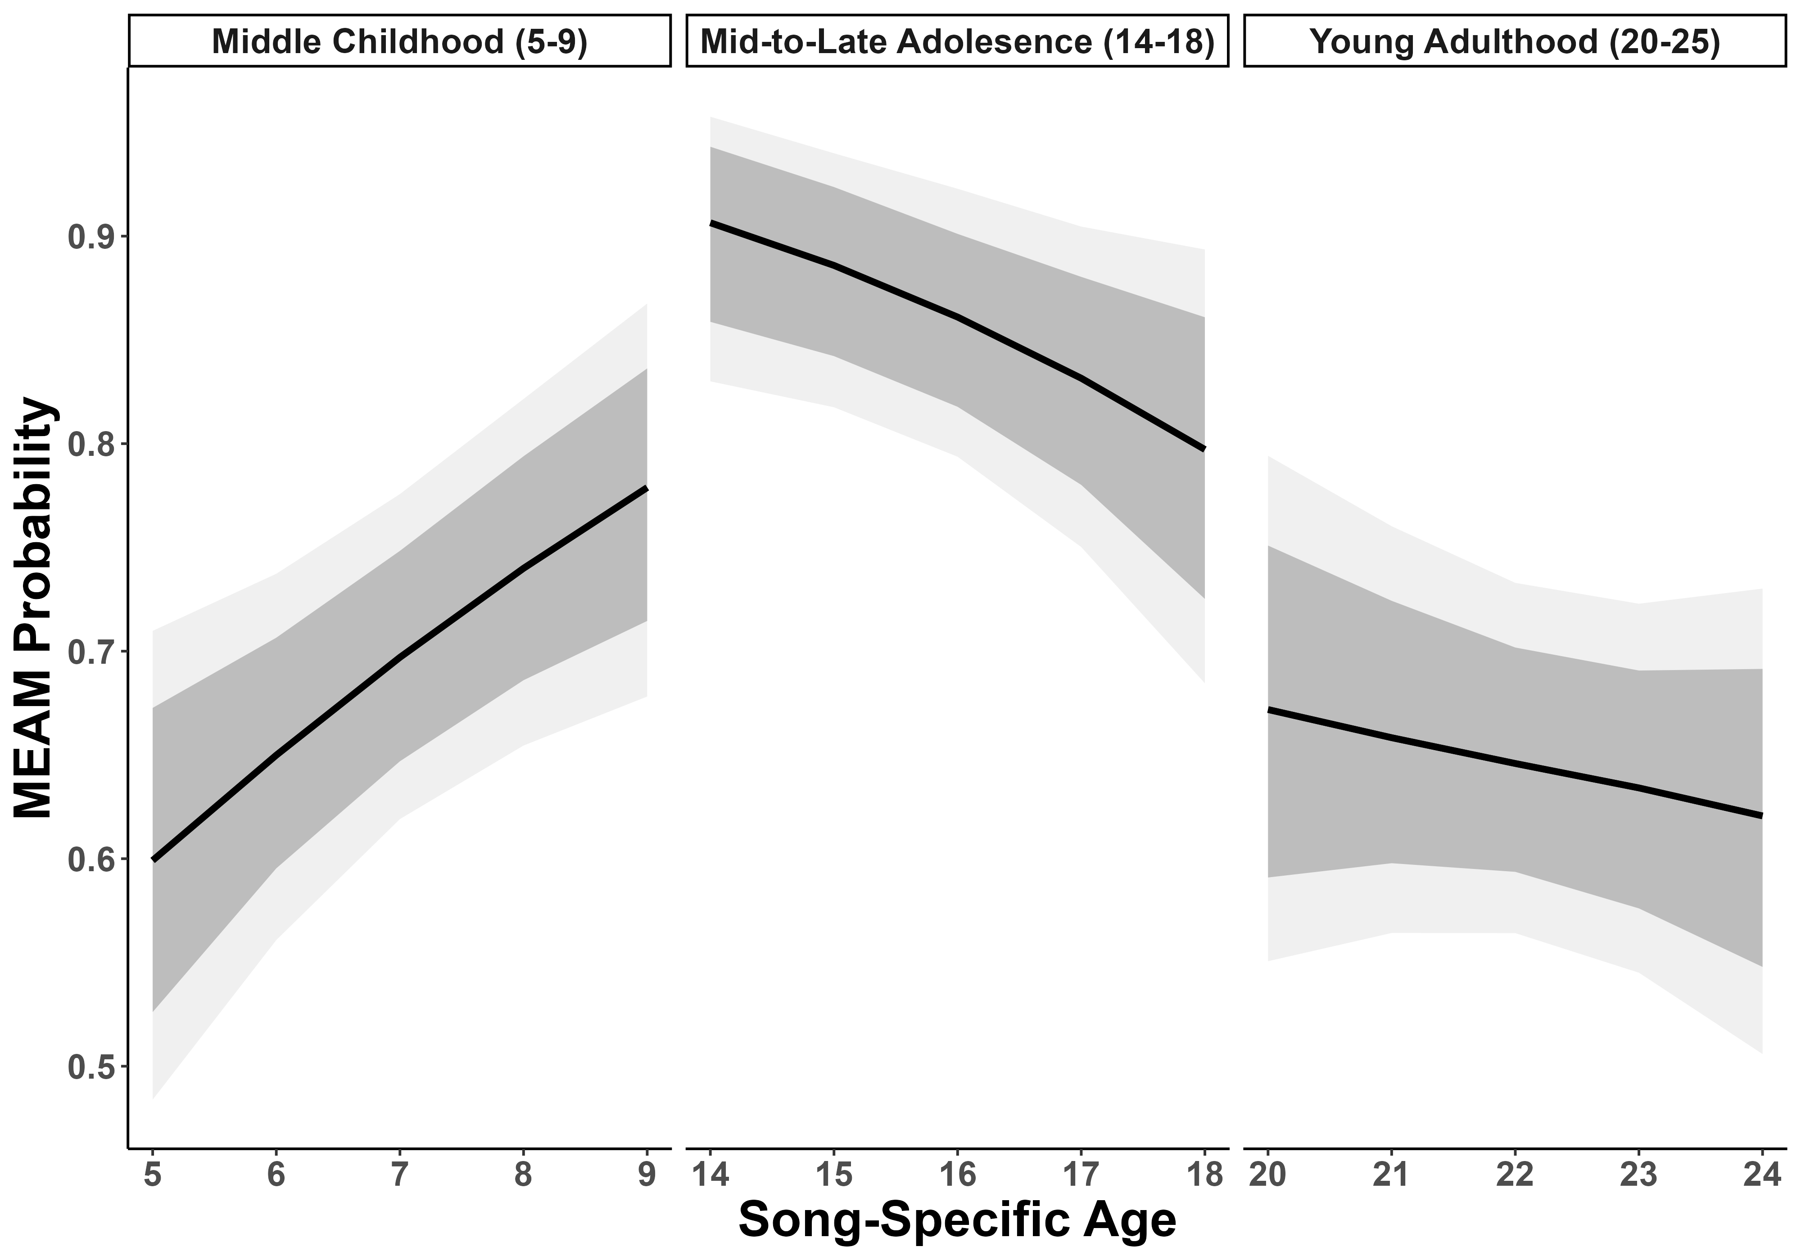
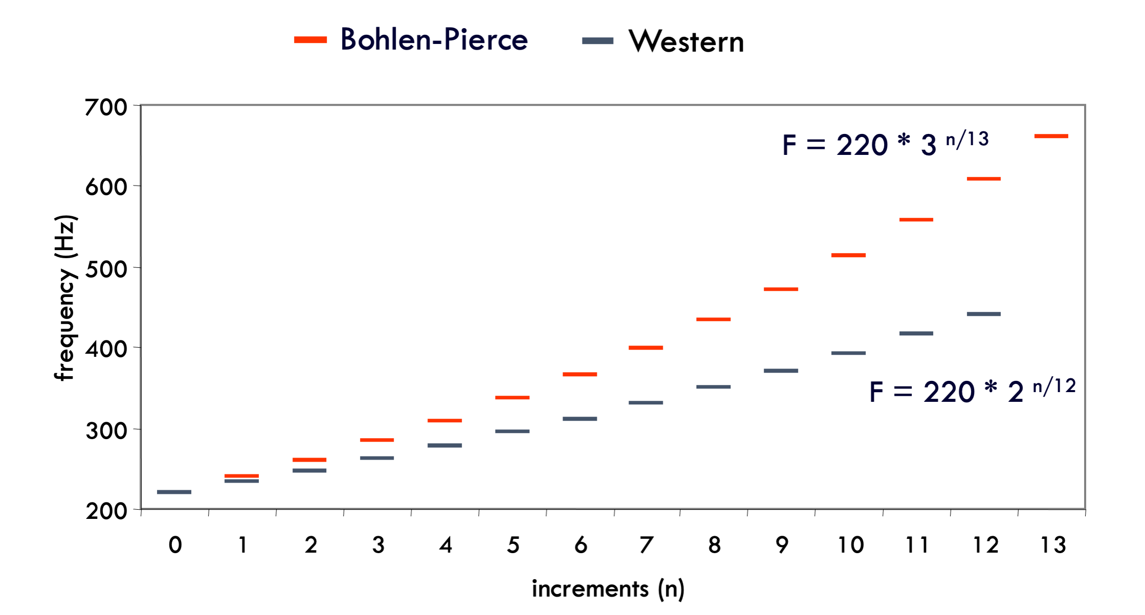
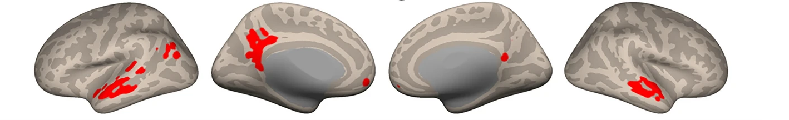

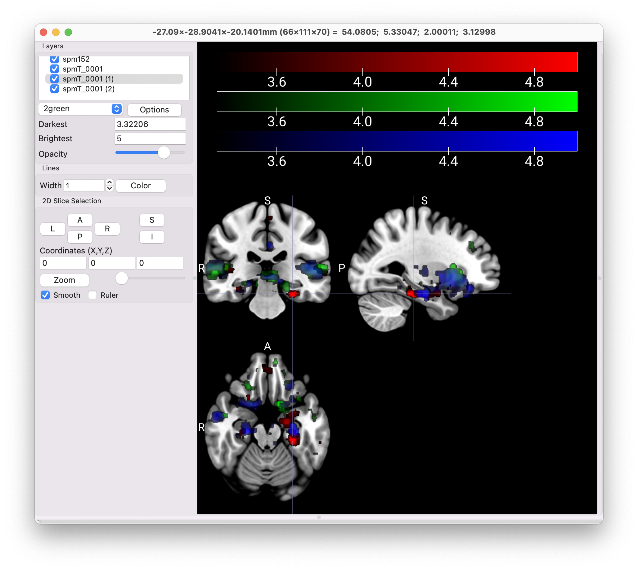
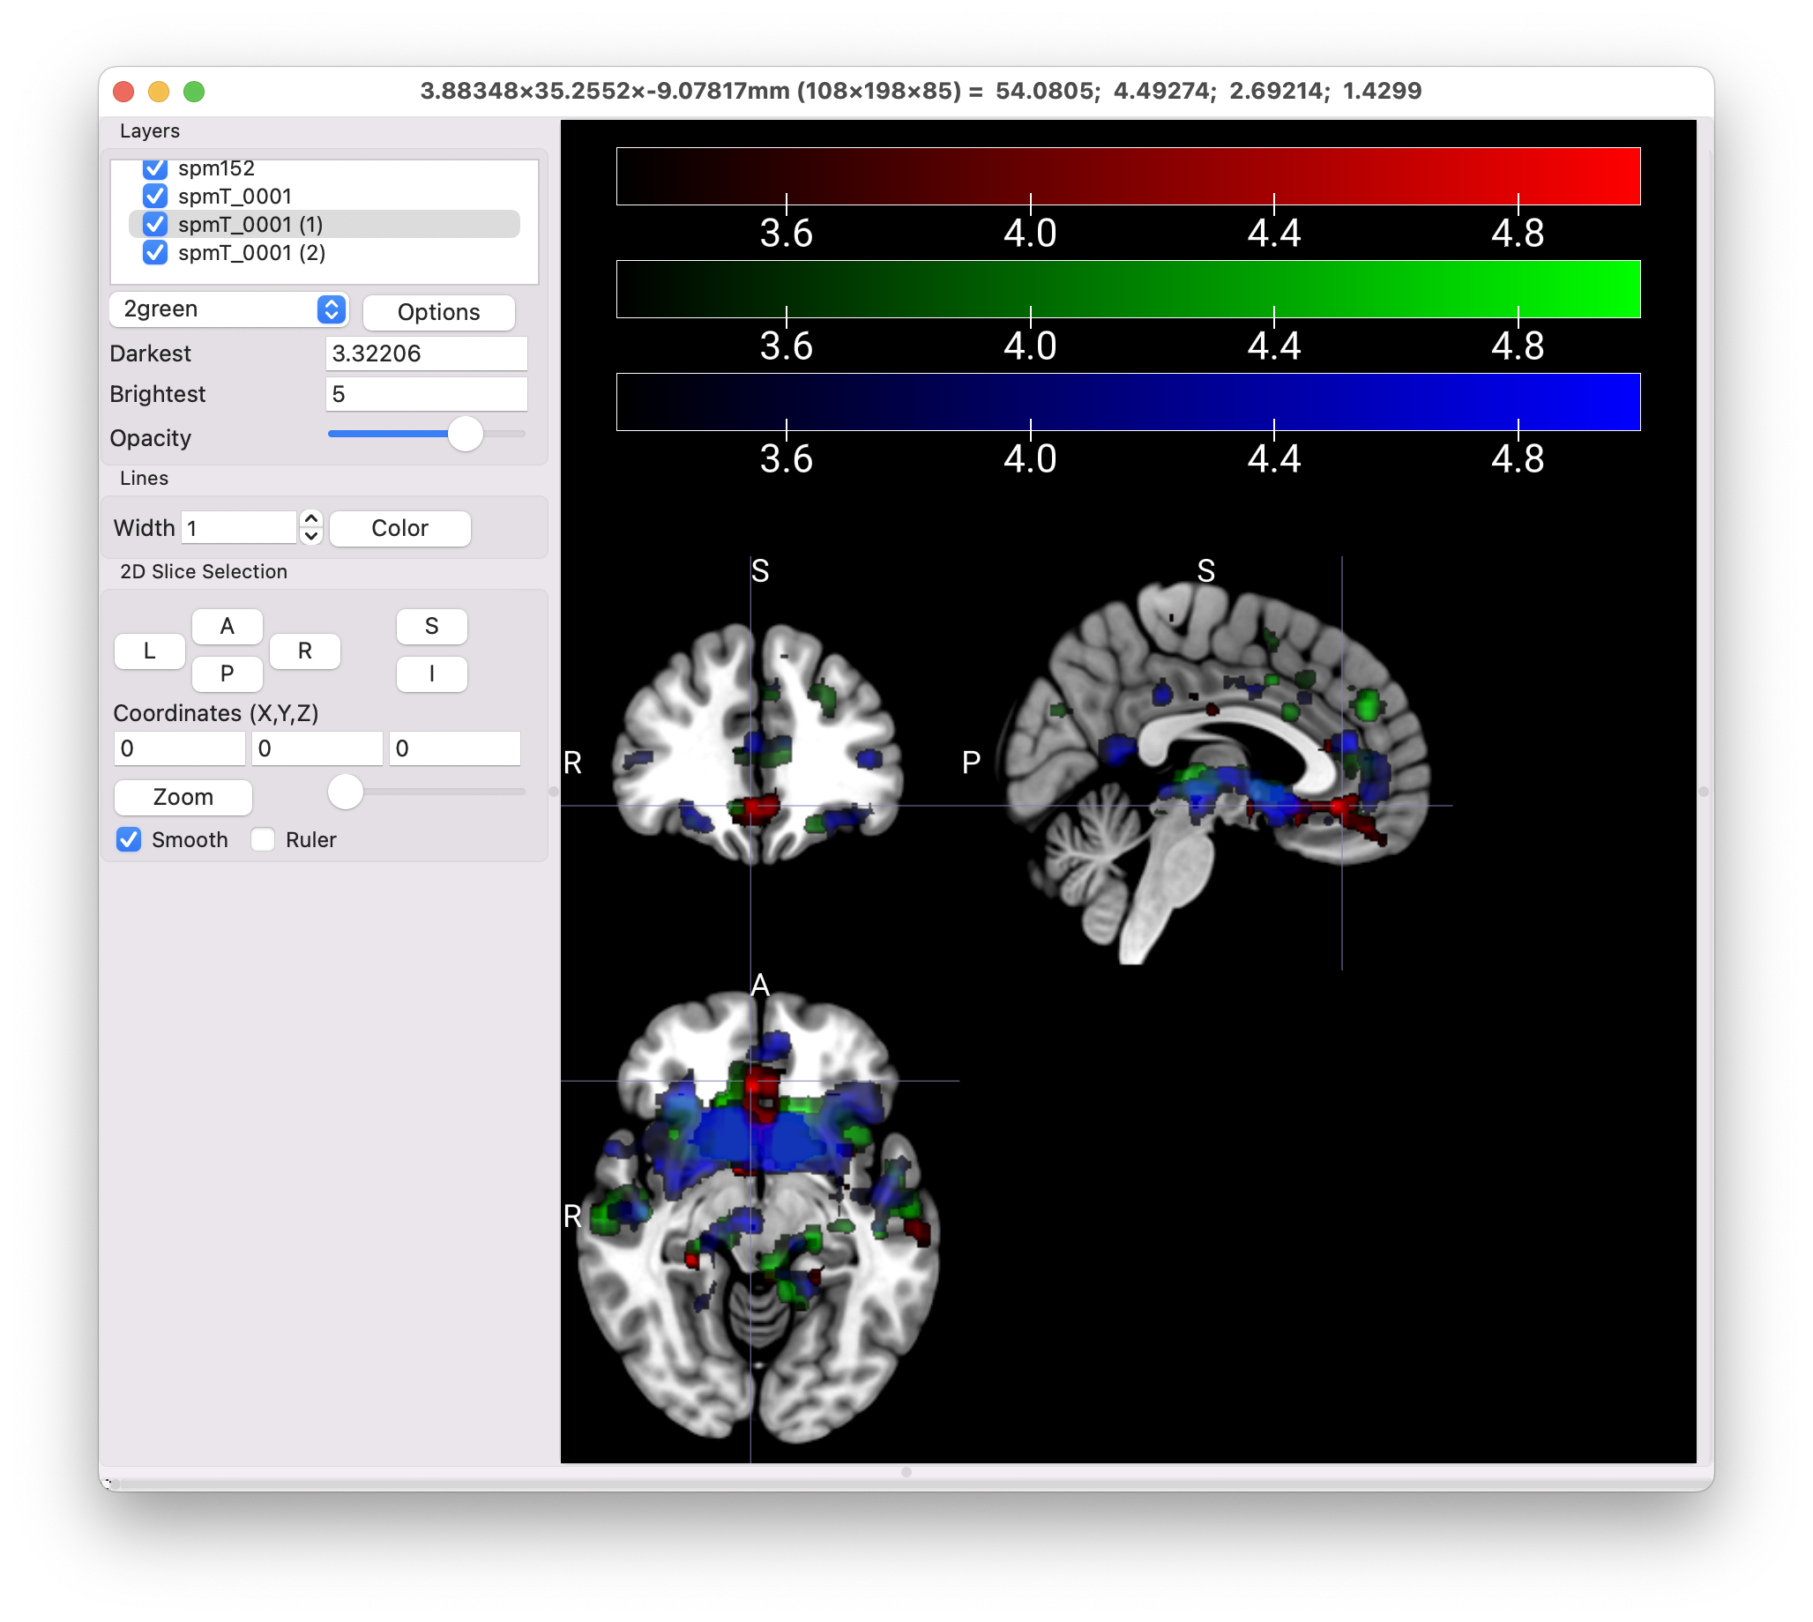
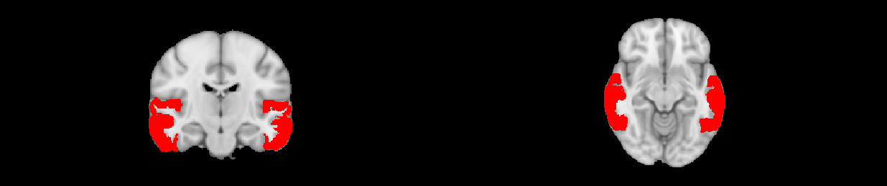
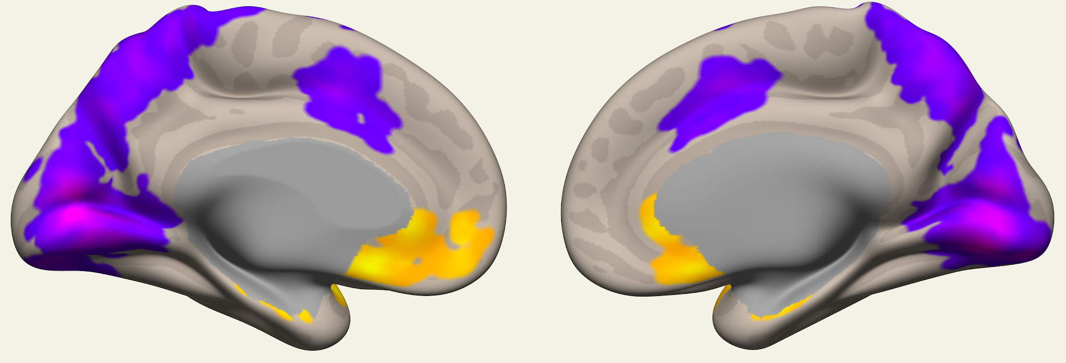
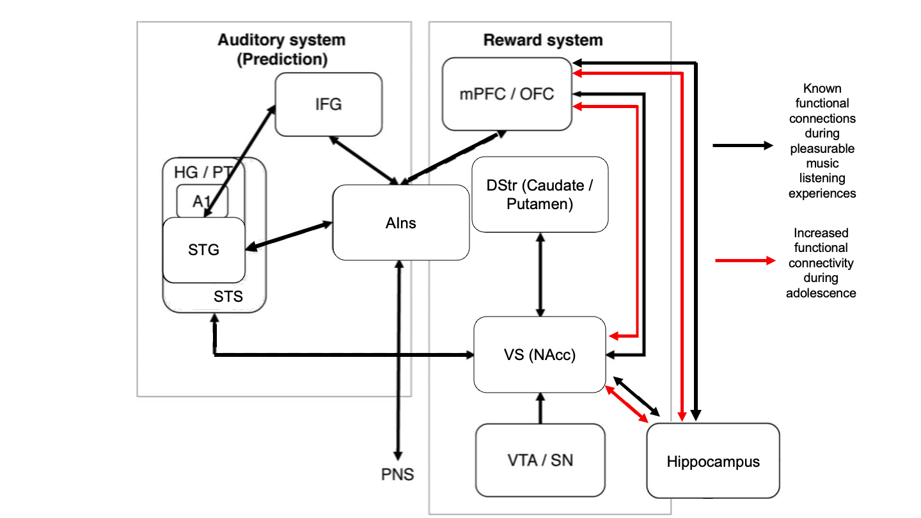
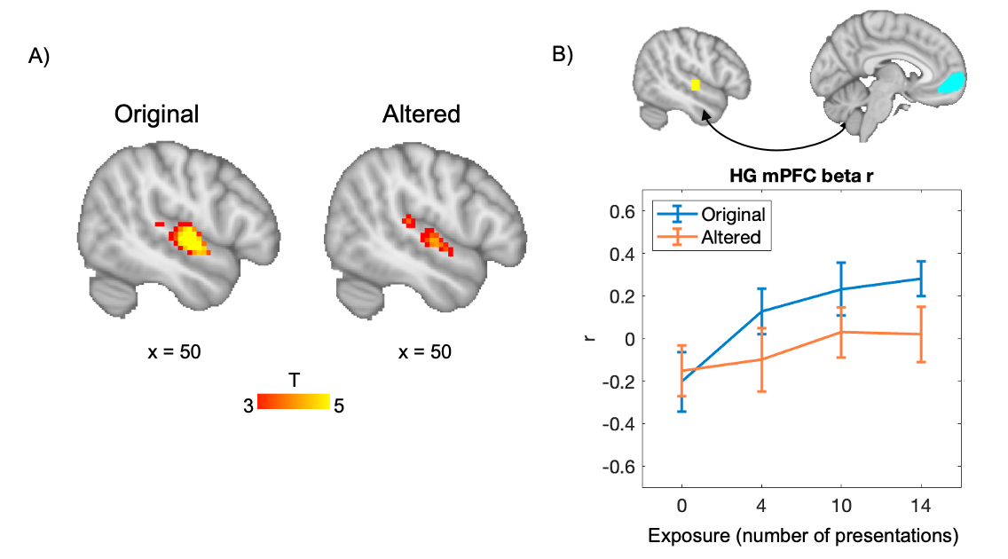
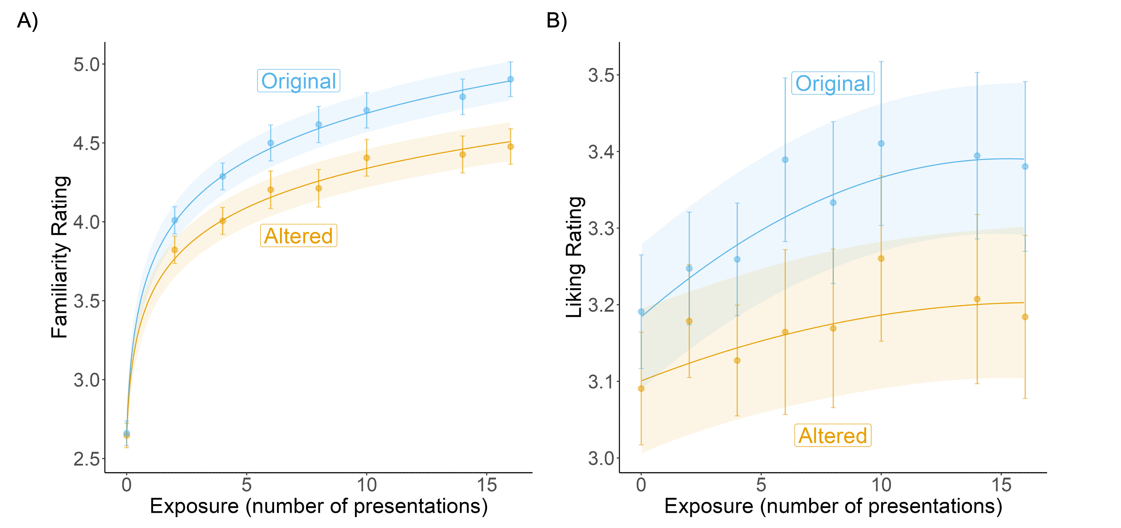



Leveraging novel music to examine age-related reward
responses across development
Nicholas Kathios, Kelsie L. Lopez, Juliet Y. Davidow, Laurel Gabard-Durnam, Psyche Loui
Northeastern University, Boston, MA
kathios.n@northeastern.edu
Introduction
Study Aim 1
Study Aim 2
Listening to music is regarded as one of the most pleasurable experiences across the lifespan¹
Pleasurable music listening experiences involve interactions between auditory and reward neural systems²
Music accrues implicit reward value by exploiting reward-prediction mechanisms: listeners tend to prefer music with predictable acoustic and structural features³
There are also lifespan differences in which music is most preferred: Older adults (ages 55+) show lifelong preference for music from adolescence, which also elicits the most spontaneous music-evoked autobiographical memories (MEAMs) in this population (the “reminiscence bump” effect⁴):
The developmental explanation for this preference bump remains unclear. Here we test a candidate mechanism:
Adolescents show heightened sensitivity to non-music reward-predictive cues and rewarding outcomes⁵, attributed to peak levels of dopamine signaling and reward system responsivity during this time⁶
Corticostriatal functional connectivity also shows positive age-related changes during adolescence⁷
Aim 1: To characterize differences in behavioral reward responses (i.e. liking ratings) to music across children, adolescents, and young adults.
Using a novel behavioral⁸ and music-listening task fMRI⁹ paradigm developed in our lab, we propose to test the relationship between participants’ liking and familiarity of novel melodies while manipulating exposure and prediction error, in a cross-sectional cohort aged 7-24
Studying how predictions relate to learning and reward is often challenging because most music that we encounter contains acoustic features listeners have been exposed to throughout their lives¹⁰
To overcome this issue, music stimuli used in this task will be written in the Bohlen-Pierce scale, a musical system acoustically different from existing scales across cultures¹¹
Developmental Hypothesis: We hypothesize that adolescents would show greater preference for melodies exposed the most during the exposure phase and greater disliking for melodies that contain a prediction error. The age-related trajectory of the fit between number of presentations and liking ratings will be best characterized by an inverse-U curve, peaking in adolescence. In contrast, there should be no age-related differences in the strength of the relationship between familiarity and number of presentations.
Power analyses from adult data indicate that a sample size of N=68 will have 80% power in detecting an effect of number of presentations on subsequent liking ratings. To account for data loss in developmental studies, we will recruit 78 participants, evenly distributed across age, to meet this sample size.
Aim 2: To compare functional connectivity during music listening across children, adolescents, and young adults, using fMRI
Developmental Hypothesis: Adolescents will show greater fronto-striatal connectivity while listening to liked music & greater hippocampal-striatal/prefrontal connectivity while listening to melodies presented more often during the behavioral task.
.
Behavioral Task
Music listening fMRI task
Dislike
BP Melodies from
Behavioral Task
Liked music engages auditory areas & mPFC
Music Year of Release – Participant Year of Birth
Music Year of Release – Participant Year of Birth
Figure from (9)
Parametric Effect of Liking
N = 16; ages 55-90
Voxel Threshold: p < 0.05 (FDR-corrected)
Cluster Threshold: p < 0.05 (FDR-corrected)
Figure from (9)
Phase 1
(pre-ratings)
Phase 2
(exposure)
Phase 3
(testing in scanner)
Auditory network & mPFC more functionally connected for younger compared to older adults during music listening
Nucleus Accumbens (NAcc) Seed
“Original” BP Melody
Childhood
Music
T
“Altered” BP Melody (contains prediction error)
Adolescent
Music
3.3
5.0
Liking?
Familiarity?
Listen
(x2,x4,x8,x16)
Liking?
Familiarity?
Adulthood
Music
Auditory Network Seed
Voxel Threshold: p < 0.05 (FDR-corrected)
Cluster Threshold: p < 0.05 (FDR-corrected)
Figure from (12)
YA (N = 24; age_{mean} = 18.6) > OA (N = 24; age_{mean} = 66.7)
Auditory cortex sensitive to PE; FC with mPFC tracks with both exposure & PE
Liking & familiarity ratings sensitive to both exposure & prediction error (PE)
Heschl’s Gyrus (HG)
Discussion
Figure from (4)
Figure adapted from (2)
Music provides a powerful, yet relatively underutilized, perspective into the neurocognitive developmental trajectory of reward responses
Music-based interventions may be particularly effective in developmental populations that experience heightened musical reward
Can age-related changes in music valuation explain lifelong increases in preference and memory associations for music from adolescence?
Research Questions:
Does heightened reward sensitivity in adolescence contribute to an increase in music reward valuation during adolescence?
How does developmental maturation of the reward system relate to changes in music preference in adolescence?
N = 665; ages 18-65
Figure from (8)
References & Acknowledgments
Dube, L., & Le Bel, J. (2003). The content and structure of laypeople’s concept of pleasure. Cogn Emot, 17(2), 263–295. https://doi.org/10.1080/02699930302295
Belfi, A. M., & Loui, P. (2020). Musical anhedonia and rewards of music listening: Current advances and a proposed model. Annals of the New York Academy of Sciences, 1464(1), 99–114. https://doi.org/10.1111/nyas.14241
Gold, B. P., Mas-Herrero, E., Zeighami, Y., Benovoy, M., Dagher, A., & Zatorre, R. J. (2019). Musical reward prediction errors engage the nucleus accumbens and motivate learning. Proc. Natl. Acad. Sci. U. S. A., 116(8), 3310–3315. https://doi.org/10.1073/pnas.1809855116
Kathios, N., Bloom, P. A., Singh, A., Bartlett, E., Algharazi, S., Siegelman, M., Shen, F., Beresford, L., DiMaggio-Potter, M., Bennett, S., Natarajan, N., Ou, Y., Loui, P., Aly, M., & Tottenham, N. (2023). Spontaneous music-evoked memories in cognitively healthy older adults: Associations between emotion, familiarity, and memory across familiar and unfamiliar music. PsyArXiv. https://doi.org/10.31234/osf.io/dpj6g
Spear, L. P. (2000). The adolescent brain and age-related behavioral manifestations. Neuroscience & Biobehavioral Reviews, 24(4), 417–463. https://doi.org/10.1016/S0149-7634(00)00014-2
Padmanabhan, A., & Luna, B. (2014). Developmental imaging genetics: Linking dopamine function to adolescent behavior. Brain and Cognition, 89, 27–38. https://doi.org/10.1016/j.bandc.2013.09.011
Davidow, J. Y., Insel, C., & Somerville, L. H. (2018). Adolescent Development of Value-Guided Goal Pursuit. Trends in Cognitive Sciences, 22(8), 725–736. https://doi.org/10.1016/j.tics.2018.05.003
9. Kathios, N., Sachs, M. E., Zhang, E., Ou, Y., & Loui, P. (2023). Generating New Musical Preferences from Multi-level Mapping of Predictions to Reward (p. 2022.06.17.496615). bioRxiv. https://doi.org/10.1101/2022.06.17.496615
10. Quinci, M. A., Belden, A., Goutama, V., Gong, D., Hanser, S., Donovan, N. J., Geddes, M., & Loui, P. (2022). Longitudinal changes in auditory and reward systems following receptive music-based intervention in older adults. Scientific Reports, 12(1), 11517. https://doi.org/10.1038/s41598-022-15687-5
11. Hannon, E. E., & Trehub, S. E. (2005). Metrical Categories in Infancy and Adulthood. Psychological Science, 16(1), 48–55. https://doi.org/10.1111/j.0956-7976.2005.00779.x
12. Loui, P., Wessel, D. L., & Kam, C. L. H. (2010). Humans Rapidly Learn Grammatical Structure in a New Musical Scale. Music Perception: An Interdisciplinary Journal, 27(5), 377–388. https://doi.org/10.1525/mp.2010.27.5.377
13. Belden, A., Quinci, M. A., Geddes, M., Donovan, N. J., Hanser, S. B., & Loui, P. (2023). Functional Organization of Auditory and Reward Systems in Aging. Journal of Cognitive Neuroscience, 1–23. https://doi.org/10.1162/jocn_a_02028
14. Ferreri, L., Mas-Herrero, E., Cardona, G., Zatorre, R. J., Antonijoan, R. M., Valle, M., Riba, J., Ripollés, P., & Rodriguez-Fornells, A. (2021). Dopamine modulations of reward-driven music memory consolidation. Annals of the New York Academy of Sciences, 1502(1), 85–98. https://doi.org/10.1111/nyas.14656
We acknowledge support from NSF-GRFP awarded to NK and seed grant funding from Northeastern University’s Center for Cognitive and Brain Health awarded to PL, JYD, and LGD.
Listen to Bohlen-Pierce melodies at this OSF Repository:
@nickkathios

